Slide 1


TensorFlow Hands-on Programming
Ton Ngo Paul Van Eck Winnie Tsang
@tango245 @pvaneckw @wtsang8
IBM Cognitive OpenTech Group

Slide 2
Morning Agenda
Deep Learning and TensorFlow ( 5 mins)
Programming concepts (15 mins)
Languages
Create and run graph
A walk through the library
MNIST: (10 mins)
Image classification domain
Dataset
Simple model (30 mins)
Regression
Build code line by line
Debugger (10 mins)
TensorBoard (20 mins)
Graph
Histogram
Images
Lunch Break
Notes:
Describe hand-out
Code is based on TensorFlow site

Slide 3
Afternoon Agenda
How to improve model (10 mins)
Options
Best practices
Neural network components (10 mins)
Convolution
Softmax
Fully connected
Dropout
Complex CNN model (55 mins)
One Convolutional Layer
Two Convolutional Layer
Fully connected layer
Dropout layer
TensorBoard embedded visualizer (10 mins)
Summary (5 mins)

Slide 4
Logistics
Prereq, install TensorFlow and Python
https://www.tensorflow.org/install/
Coding:
Morning session: type and run code exercises
Afternoon session: download from github and run code exercises
Github:
https://github.com/tonanhngo/handon-tensorflow
Hand-out:
Successive code segments for each exercise, 0 to 16
Presentation chart available at:
http://bit.ly/2vU3Oex

Slide 5
Deep Learning and TensorFlow

Slide 6
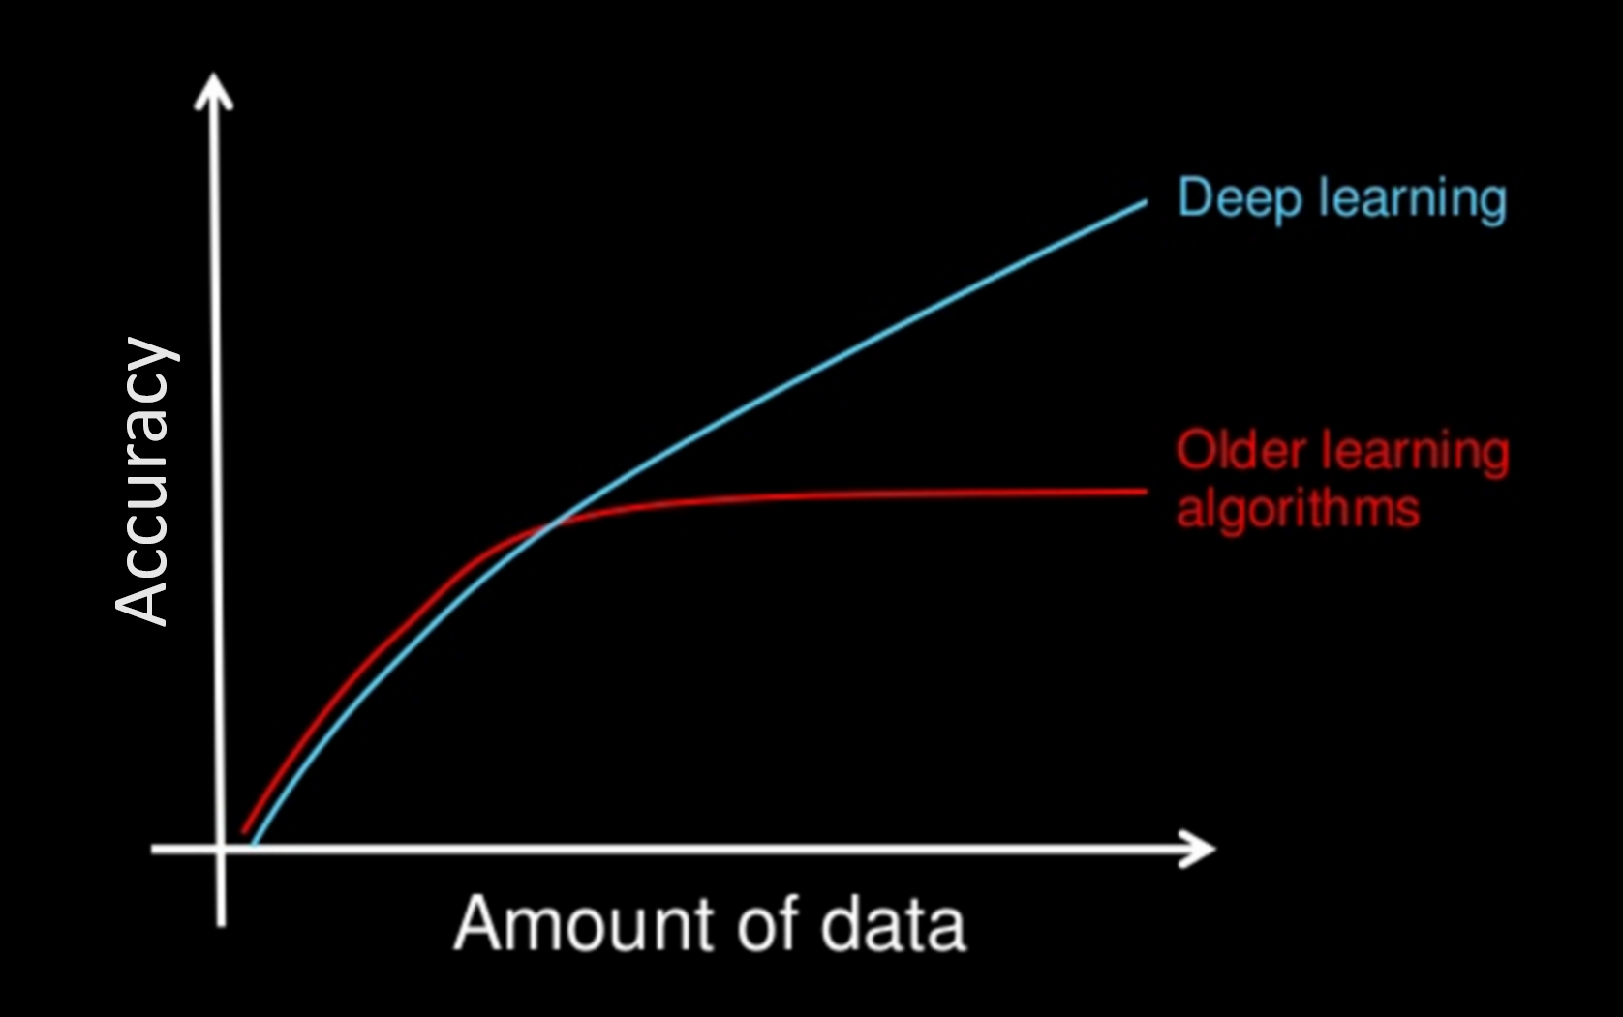
Machine Learning vs Deep Learning

Slide 7
TensorFlow From Google
Open sourced November 2015
Re-designed for research and production
Rapid adoption
5,500 github repo with Tensorflow in the title
Taught in universities classes (Stanford, Berkeley, Toronto, ....)
Fast growing community
12K+ Q&A on stackoverflow
IBM support:
IBM PowerAI, Power System S822LC
IBM Data Science Experience
Watson Machine Learning Platform

Slide 8
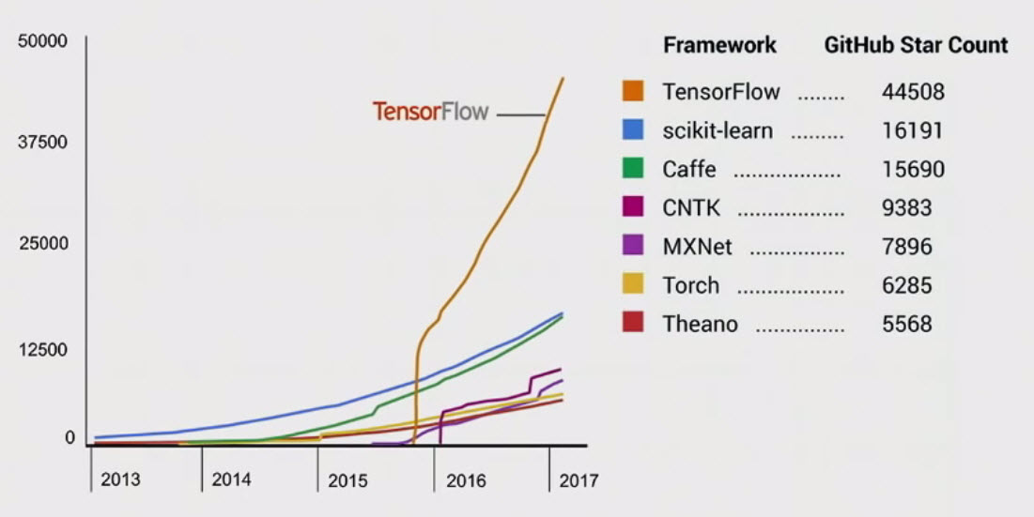
Github Activity (source TensorFlow Dev Summit 2017)
Notes:
Part 2.b: Why Tensorflow
Contributors: 475+ non Google contributors to version 1.0
Google AlphaGo competition: defeated Korean grandmaster Lee Sedol, finishing the best-of-five series with four wins and one loss

Slide 9
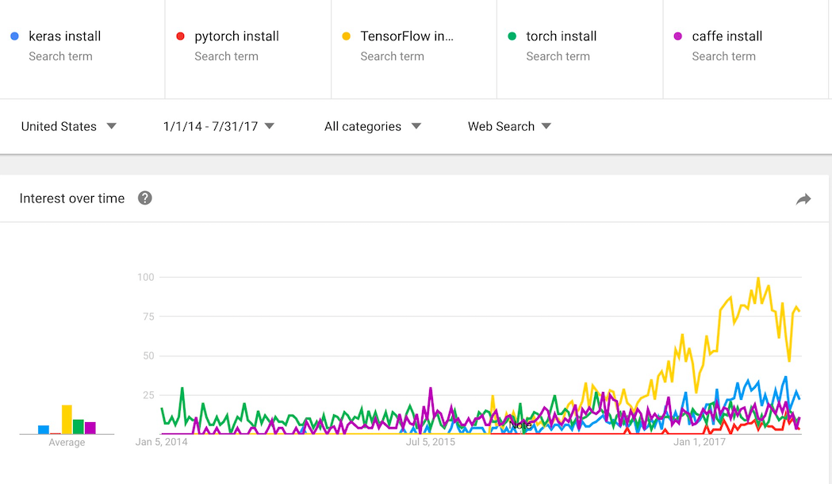
Download & install trend

Slide 10
2. Programming Concepts

Slide 11
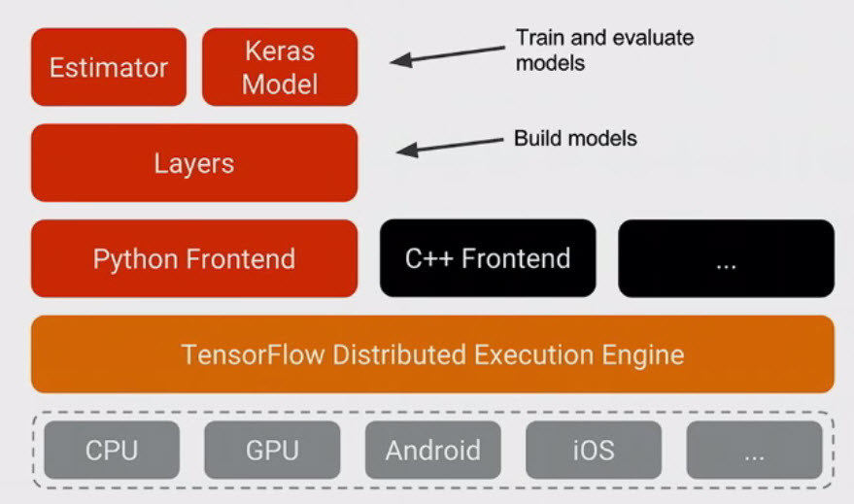
TensorFlow Components (source TensorFlow Dev Summit 2017)
Notes:
Part 3.a: Components

Slide 12
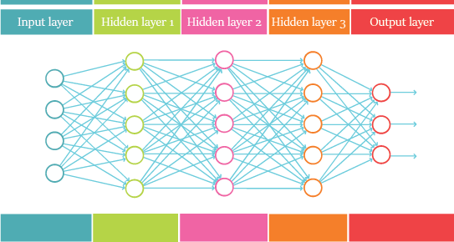
Deep Learning basic operation
Neural net is a graph
Map x -> y
Data flow: left to right
Each cell “fires” based in input and its weight
Tweak all weights until output matches expected outcome
x
y
Notes:
Analogous to tuning to a station on an analog radio: dial knob until sound is clearest

Slide 13
How to implement neural net
Functional language:
Scala, ...
Graph is natural, built into the language
Procedural language:
Python, Java, C, …
Graph needs to be created separately
TensorFlow approach
Provide library to build and run graph
Language binding via clients for specific language Create graph as fit for language
Runtime to execute graph

Slide 14
TensorFlow Graph
Construct graph: use tf objects
Node: operation
Edge: data (tensor)
Execute graph: connect to runtime
Initialize variables
Load data, feed through graph
Train model: compute parameters, loss
Save checkpoints
Distribute workload
Runtime
Compute, loss function
Traning data
prediction
Notes:
Explain tensor, where name comes from
Python is an imperative language, but here we are using it to solve a dataflow problem
A functional language like R or Scala would be more natural
Given this, a TensorFlow program in Python will feel a little different from a typical Python program

Slide 15
Create graph: tensors
tf.constant(...)
Immutable value
Usually for initializing variables
tf.Variable(...)
Must be initialized before run
Value to be modified during training
Can be assigned value during execution
Generally constitute the internal trained model
tf.placeholder(...)
Value to be provided at runtime in feed_dict{..}
Generally used for the input
op
tensor
op
tensor
op

Slide 16
Create graph: nodes
Tensor operations
Reshape
Multiply
...
Algorithms
Convolution
Softmax
...
op
tensor
op
tensor
op

Slide 17
Operate on graph
Loss function
How far off is the prediction from the given label
Optimizer
How to tweak the parameters to minimize loss
Variable values
Initialize
Assign value
Utilities
Checkpoint / restore
Dump data for TensorBoard, debugger
...

Slide 18
Library
Web: https://www.tensorflow.org/api_docs/
Implementation: https://github.com/tensorflow/tensorflow
Modules used in our coding exercises:
tf
tf.nn
tf.train
tf.summary
Notes:
Python API guide: group by logical functionality, useful for finding what you need
The module list: good for reference, finding out what the call needs and does
Each module has an overview section, listing the API with some explanation
Classes
Functions
Each API link show the implementation code, document and API description

Slide 19
3. MNIST

Slide 20

MNIST Dataset
The MNIST dataset consists of 60,000 images of handwritten digits like:
Each image has an associated label denoting which digit it is. The above images would have labels 5, 0, 4, and 1.

Slide 21
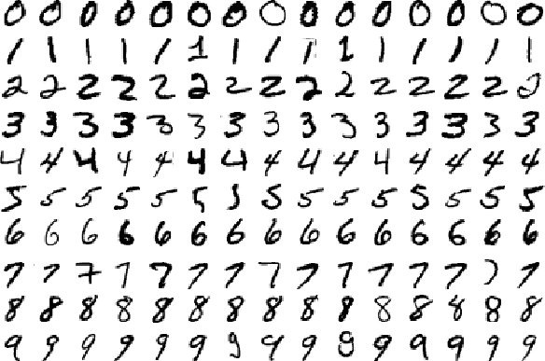
Problem Description: Image Classification
We want to be able to train a deep learning model using the MNIST dataset that will be able to look at images and predict what digits they are.

Slide 22
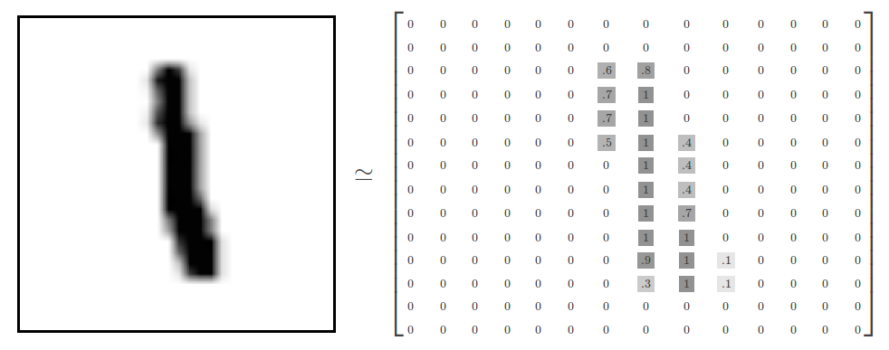
Computer Vision
How machines view images:

Slide 23
4. Code version 1: Regression

Slide 24
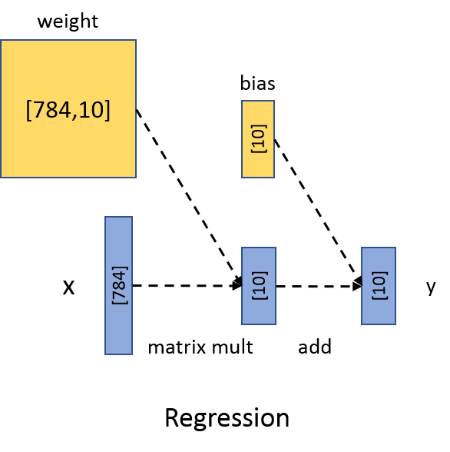
Tensors for Regression
Placeholder:
28x28 image flattened into a vector: [784]
Variables:
Weight is a 2D array: [784,10]
Bias is a vector: [10]
Prediction is simply:
y = x * weight + bias
Optimizer adjusts weight and bias to minimize loss (error)
Predicted y is close to label

Slide 25
Implement Read data
See #0 in hand-out
input_data is a utility function provided by TensorFlow to retrieve MNIST dataset
One_hot refers to how the labels will be represented: as one-hot vectors
One-hot vector is a vector which is 0 in most dimensions, and 1 in a single dimension.
E.g. 3 = [0, 0, 0, 1, 0, 0, 0, 0, 0, 0]
from tensorflow.examples.tutorials.mnist import input_data import tensorflow as tf def main(): mnist = input_data.read_data_sets("MNIST_data/", one_hot=True)
if __name__ == '__main__': main()
Notes:
Imports + Download + Read MNIST data to a local directory
code-00-ReadData.py

Slide 26
Implement Placeholders
See #1 in hand-out
Placeholders are input
x is a 2D array for the images:
Each row is one flattened 28x28 image
First dimension is “None”, to be used to pull in a batch of images at a time (more later)
y_ is 2D array for the labels:
Second dimension 10 for the one-hot representation
# Placeholder that will be fed image data.
x = tf.placeholder(tf.float32, [None, 784])
# Placeholder that will be fed the correct labels.
y_ = tf.placeholder(tf.float32, [None, 10])
Notes:
Define placeholder as input for character image and label
code-01-Placeholders.py

Slide 27
Implement Weight and Bias
See #2 in hand-out
Weight and Bias are variables: to be tweaked during training
Weight is a 2D array: 784 x 10
Bias is a vector: 10
Initialized with certain values: important for optimization algorithm
def weight_variable(shape):
"""Generates a weight variable of a given shape."""
initial = tf.truncated_normal(shape, stddev=0.1)
return tf.Variable(initial)
def bias_variable(shape):
"""Generates a bias variable of a given shape."""
initial = tf.constant(0.1, shape=shape)
return tf.Variable(initial)
# Define weight and bias.
W = weight_variable([784, 10])
b = bias_variable([10])
Notes:
Define initial set of weight and bias: arrays of size 784 and 10
To process a set of image at a time, add a second dimension but leave it as undefined
code-02-VariableFunctions.py
One should generally initialize weights with a small amount of noise for symmetry breaking, and to prevent 0 gradients. Since we're using ReLu neurons, it is also good practice to initialize them with a slightly positive initial bias to avoid "dead neurons"
Tf.truncated_normal is a function that produces random values following the normal (Gaussian) distribution between -2*stddev and +2*stddev

Slide 28
Implement Regression and Loss Optimizer
See #3 in hand-out
Neural network: Regression + SoftMax
Loss function: how far off is the prediction from the label
Optimizer algorithm: how to tweak the variables
# Here we define our model which utilizes the softmax regression.
y = tf.nn.softmax(tf.matmul(x, W) + b)
# Define our loss.
cross_entropy = tf.reduce_mean(-tf.reduce_sum(y_ * tf.log(y), reduction_indices=[1]))
# Define our optimizer.
train_step = tf.train.GradientDescentOptimizer(0.5).minimize(cross_entropy)
Notes:
Simple regression model: just multiply weight, add bias (softmax)
Choose:
loss function: how far off is the prediction from the label
optimizer algorithm: how to
code-03-ModelLossOptimizer.py

Slide 29
What is Softmax?
Function that is good for assigning probabilities to an object being one of several things.
A softmax regression has two steps:
Add up the evidence of our input being in certain classes
Convert that evidence into probabilities
Sum of all outputs will be equal to 1.0

Slide 30
Calculate Accuracy
See #4 in hand-out
Compare label against result predicted by model
Recall y_ is the label for each image, provided as input
We use tf.equal to check if our prediction matches the truth. This gives us a list of booleans.
To determine what fraction are correct, we cast to floating point numbers and then take the mean (reduce_mean).
# Define accuracy.
correct_prediction = tf.equal(tf.argmax(y,1), tf.argmax(y_,1))
correct_prediction = tf.cast(correct_prediction, tf.float32)
accuracy = tf.reduce_mean(correct_prediction)
Notes:
Define our accuracy using average of correct cases
code-04-DefineAccuracy.py

Slide 31
Create Session connecting to Runtime
See #5 in hand-out
Here, session connects to the local runtime on your laptop
You can connect to a runtime on a remote cluster for large scale training
Distributed Tensorflow
Different types of session:
Normal session to run full training
Interactive session for modifying neural network on the fly
# Launch session.
sess = tf.InteractiveSession()
Notes:
Run graph: connect to session
code-05-RunGraphWithError.py

Slide 32
Train and Evaluate Model
Here, we run our training step 1100 times, feeding in batches of data to replace the placeholders.
The batches are random data points we retrieve from our image training set.
We then check the model with the test data to get our accuracy.
# Do the training.
for i in range(1100):
batch = mnist.train.next_batch(1)
sess.run(train_step, feed_dict={x: batch[0], y_: batch[1]})
# See how model did.
print("Test Accuracy %g" % sess.run(accuracy, feed_dict={
x:mnist.test.images, y_: mnist.test.labels}))
Notes:
code-05-RunGraphWithError.py

Slide 33
Run initial version
Why the error?
See #6 in hand-out
All variables are uninitialized and needs to be initialized before executing the graph
Initializing with the appropriate value is important for the optimizer
# Initialize variables.
tf.global_variables_initializer().run()
Notes:
Forgot to initialize variable, see errors in runtime
add variable initialization: softmax version running correctly
code-06-WorkingBasic.py

Slide 34
Modify Input Batch
See #7 in hand-out
What does batch size do?
batch = mnist.train.next_batch(100)
if i % 100 == 0:
train_accuracy = sess.run(accuracy, feed_dict={x:batch[0], y_: batch[1]})
print("Step %d, Training Accuracy %g" % (i, float(train_accuracy)))
Notes:
Update batch size from 1 to 100.
Add logging to every 100th iteration in the training process

Slide 35
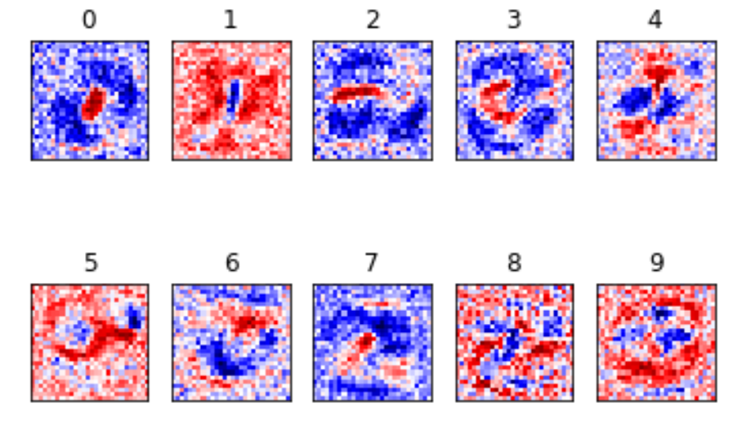
Learned Weights for Each Digit
Red represents negative weights, while blue represents positive weights.

Slide 36
5. Debugger

Slide 37
tfdbg
Typical debugger:
Stop at breakpoint or error
Inspect variables, single step, continue, …
Differrence
Normal python debugger not applicable
Need to work on graph during training or inference
How tfdbg works:
Wrapper around session
Stop before and after each session.run()
Inspect variables, continue, step through graph
Breakpoint by plugin: code looks for condition to break, e.g. inf, nan
Tool still basic and primitive, expect improvement in subsequent releases

Slide 38
Add code for tfdbg
Add 2 lines of code
Import package
Wrap session
Comment out or skip line when not debugging
from tensorflow.python import debug as tf_debug
sess = tf_debug.LocalCLIDebugWrapperSession(sess)
Notes:
code-07-IncreasedBatchDebug.py

Slide 39
6. TensorBoard

Slide 40
TensorBoard
A suite of visualization tools for TensorFlow
Graph
Summary data (histogram, scalar, image, etc)
Embedding
Post-mortem analysis
Add code to generate data
Run TensorBoard, access on browser

Slide 41
TensorFlow Graph
Create TensorFlow event file (see #8 in hand-out)
Add FileWriter along with the graph
Run the model
Run TensorBoard
View TensorBoard on a browser
tensorboard --logdir=path/to/log-directory
LOGDIR = './tensorflow_logs/mnist_deep'
# Create summary writer
writer = tf.summary.FileWriter(LOGDIR, sess.graph)
# Close summary writer
writer.close()

Slide 42
TensorFlow Graph
Grouping nodes by name scopes (see #9 in hand-out)
return tf.Variable(initial, name='weight')
return tf.Variable(initial, name='bias')
x = tf.placeholder(tf.float32, [None, 784], name='x')
y_ = tf.placeholder(tf.float32, [None, 10], name='labels')
with tf.name_scope('softmax'):
y = tf.nn.softmax(tf.matmul(x, W) + b, name='y')
with tf.name_scope('loss'):
cross_entropy = tf.reduce_mean(-tf.reduce_sum(y_ * tf.log(y),
reduction_indices=[1]), name='cross_entropy')
with tf.name_scope('optimizer'):
train_step = tf.train.GradientDescentOptimizer(0.5).minimize(cross_entropy, name='train_step')
with tf.name_scope('accuracy'):
correct_prediction = tf.equal(tf.argmax(y,1), tf.argmax(y_,1))
correct_prediction = tf.cast(correct_prediction, tf.float32, name='correct_prediction')
accuracy = tf.reduce_mean(correct_prediction, name='accuracy')
Notes:
Most construct has “name” as a parameter, add them to make it easier to read, replace the autogenerated name
Python construct “with”, use tf.name_scope() to group nodes
The better your name scopes, the better your visualization

Slide 43
Image
See #10 in hand-out
View images from input or computed internally in the layers
Debug, get insight
with tf.name_scope('reshape'):
x_image = tf.reshape(x, [-1, 28, 28, 1])
tf.summary.image('input', x_image, 4)
if i % 5 == 0:
summary = sess.run(merged,
feed_dict={x: batch[0], y_: batch[1]})
writer.add_summary(summary, i)
# Merge all the summary data
merged = tf.summary.merge_all()

Slide 44
Histogram and Scalar
See #11 in hand-out
W = weight_variable([784, 10])
tf.summary.histogram('weight', W)
b = bias_variable([10])
tf.summary.histogram('bias', b)
with tf.name_scope('softmax'):
...
tf.summary.histogram('softmax', y)
with tf.name_scope('loss'):
...
tf.summary.scalar('loss', cross_entropy)
with tf.name_scope('accuracy'):
...
tf.summary.scalar('accuracy', accuracy)

Slide 45
7. How to Improve

Slide 46
Options for improving model
Softmax Regression model
Accuracy peaks at 92%
Techniques to improve accuracy:
Tweak algorithm parameters
Run training longer
Get more data
Bigger model
New model architecture
How to choose which techniques?
Analysis, experience, domain insight

Slide 47
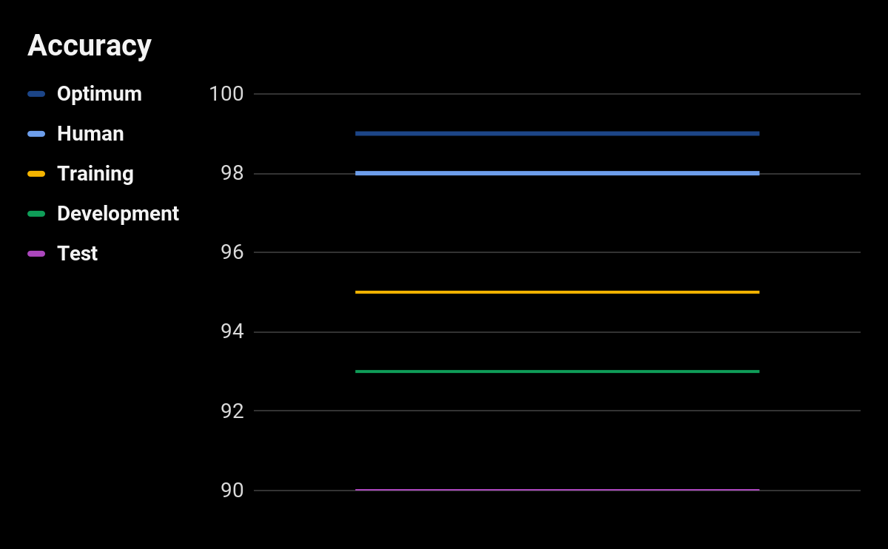
Guidelines
Insight from Andrew Ng, DL School, 9/2016 Consider accuracy at different levels, Look at the gap between:
Optimum (not perfect)
Human level
Training data (~70% data)
Development data (~15% data)
Test data (~15% data)
Note: 2-5 not necessarily in this order
Notes:
Andrew Ng is AI professor at Stanford, head of Baidu AI division

Slide 48
Guidelines
Large gap between Human and Training accuracy
High bias
Options
Bigger model
Train longer
New model architecture
Iterate until Training accuracy high
Large gap between Training and Development accuracy
High variance, overfitting problem
Options:
More data
Add regularization
New model architecture
Iterate until Development accuracy high
Notes:
Always have a way out: bigger model, more data
Used to have to worry about trade-off between bias and variance
Bigger model -> more computation More data -> more investment

Slide 49
8. Neural Network Components

Slide 50
Convolution
Procedure where two sources of information are intertwined.
Used to extract features from the input image.
Preserves the spatial relationship between pixels by learning image features using small squares of input data.

Slide 51
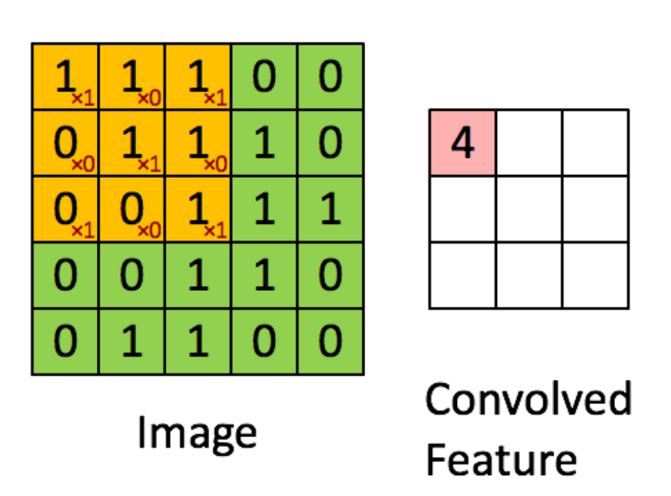
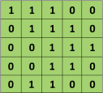

Convolution
Consider a 5x5 binary image matrix whose pixel values are either 0 or 1:
Now consider a 3x3 second matrix:

Slide 52
Convolution of the Two Matrices
Stride: 1
Padding: None
Notes:
Kernels are then convolved with the input volume to obtain so-called ‘activation maps’ (also called feature maps).
Activation maps indicate ‘activated’ regions, i.e. regions where features specific to the kernel have been detected in the input.

Slide 53
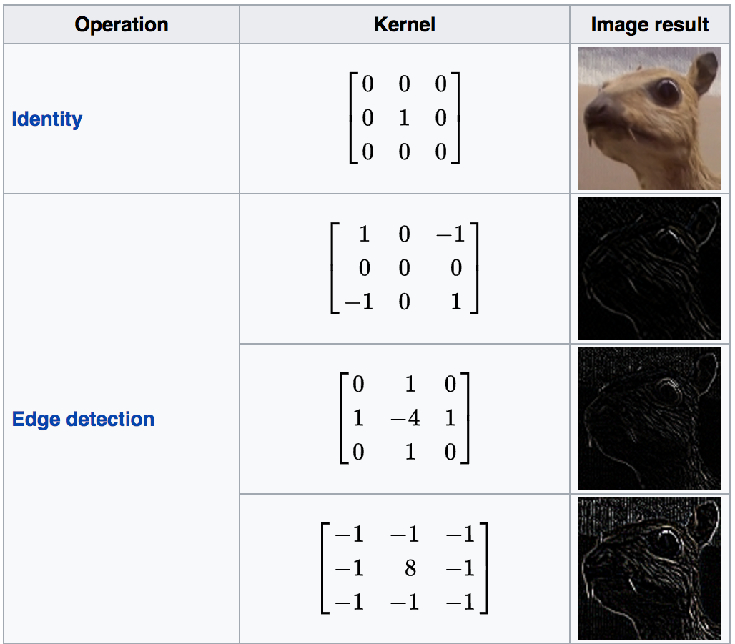
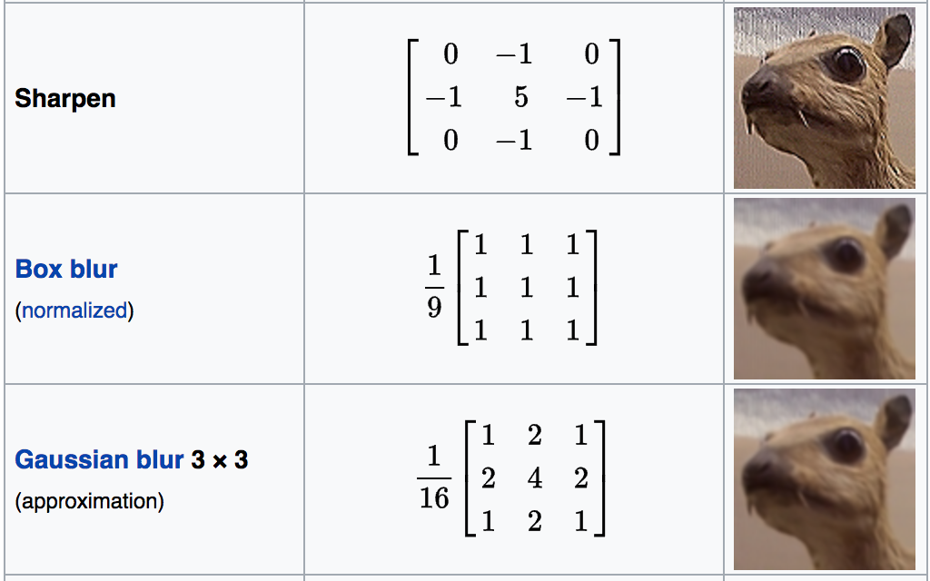
Effects of Convolution with Different Kernels
Source: https://en.wikipedia.org/wiki/Kernel_(image_processing)

Slide 54
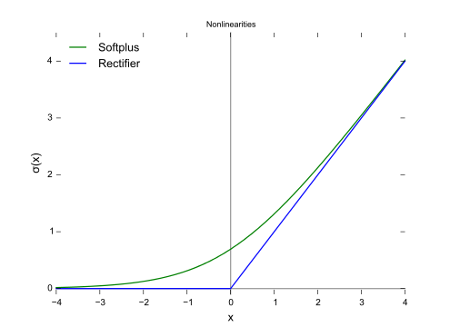
ReLu (Rectified Linear Unit)
Activation function to introduce non-linearity
Make our model able to learn nonlinear functions
Makes the network invariant to small transformations, distortions and translations in the input image
f(x) = max(0, x)
All negative numbers turn zero.
Notes:
keep the math from breaking by turning all negative numbers to 0) (RELU) a stack of images becomes a stack of images with no negative values After each conv layer, it is convention to apply a nonlinear layer (or activation layer) immediately afterward.The purpose of this layer is to introduce nonlinearity to a system that basically has just been computing linear operations during the conv layers (just element wise multiplications and summations).In the past, nonlinear functions like tanh and sigmoid were used, but researchers found out that ReLU layers work far better because the network is able to train a lot faster (because of the computational efficiency) without making a significant difference to the accuracy.

Slide 55
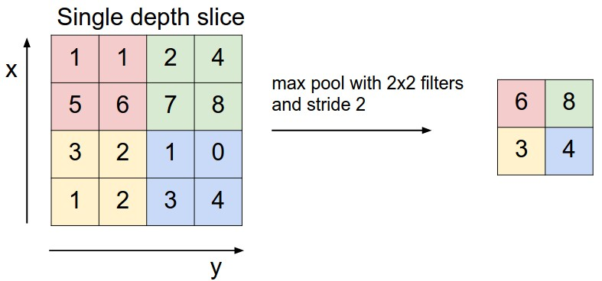
Pooling (also known as Downsampling)
Pooling reducing the spatial dimensions (Width x Height) of the input volume
Depth dimension is not affected
Reduces computational complexity.
Types of pooling: Max, Average
Source: http://cs231n.github.io/convolutional-networks
Notes:
depth of the output volume is a hyperparameter: it corresponds to the number of filters we would like to use, each learning to look for something different in the input

Slide 56
Layers so far….
Convolution (extract the useful features from the images)
ReLU (introduce non-linearity)
Pooling (reduce feature dimension)
Notes:
Together these layers extract the useful features from the images, introduce non-linearity in our network and reduce feature dimension while aiming to make the features somewhat equivariant to scale and translation

Slide 57
Fully Connected Layer
Fully Connected denotes that every neuron in the previous layer is connected to every neuron on the next layer
Allows processing on the entire image
Looks at the output of the previous layer to determine which features most correlate to a particular class

Slide 58
Dropout layer
Overfitting problem: with large model, the optimizer can cause the model to “memorize” the mapping
Effect: accuracy can be high during training, but low during testing when new images not seen before are presented to the model
Solution: Dropout layer disables a percentage of the nodes in the layer
Force algorithm to generalize from patterns instead of memorizing them

Slide 59
9. Code version 2: CNN

Slide 60
Design for Convolutional Neural Network
We will create a CNN to classify MNIST images with the following layers:
Input - MNIST dataset
Convolutional and Max-Pooling
Convolutional and Max-Pooling
Fully Connected Layer
Processing - Dropout
Readout layer - Fully Connected
Outputs - Classified digits

Slide 61
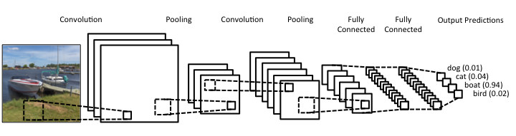
Full CNN
+ ReLU
+ ReLU

Slide 62
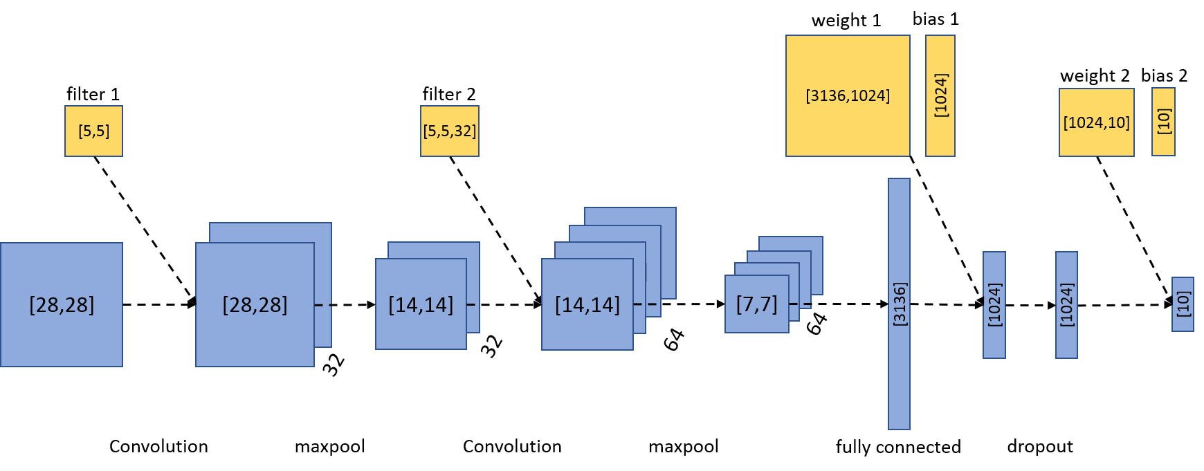
Tensors for each layers
Notes:
Blue boxes are input or computed result from input
Yellow boxes are variables tweaked by the algorithm during learning
Yellow boxes + graph = trained model

Slide 63
Implement First CNN Layer (1)
See #12 in hand-out
Kernel weight and bias are defined. The size of the kernel/filter is 5x5. Input channels is 1 since the images are grayscale
Create 32 images by the filters: these represent 32 different features of the digit (can choose other number of features)
Filters are chosen by the algorithm
# Convolutional layer - maps one grayscale image to 32 features.
with tf.name_scope('conv1'):
W_conv1 = weight_variable([5, 5, 1, 32])
b_conv1 = bias_variable([32])
x_conv1 = tf.nn.conv2d(x_image, W_conv1, strides=[1, 1, 1, 1], padding='SAME')
h_conv1 = tf.nn.relu(x_conv1 + b_conv1)

Slide 64
Implement First CNN Layer (2)
Perform max pooling with kernel size 2x2 and 2 pixel strides each direction.
The resulting image should be ¼ the size.
Scale down and flatten into a vector
# Pooling layer - down samples by 2X.
with tf.name_scope('pool1'):
h_pool1 = tf.nn.max_pool(h_conv1, ksize=[1, 2, 2, 1],
strides=[1, 2, 2, 1], padding='SAME')
# After downsampling, our 28x28 image is now 14x14
# with 32 feature maps.
with tf.name_scope('flatten'):
h_pool_flat = tf.reshape(h_pool1, [-1, 14*14*32])

Slide 65
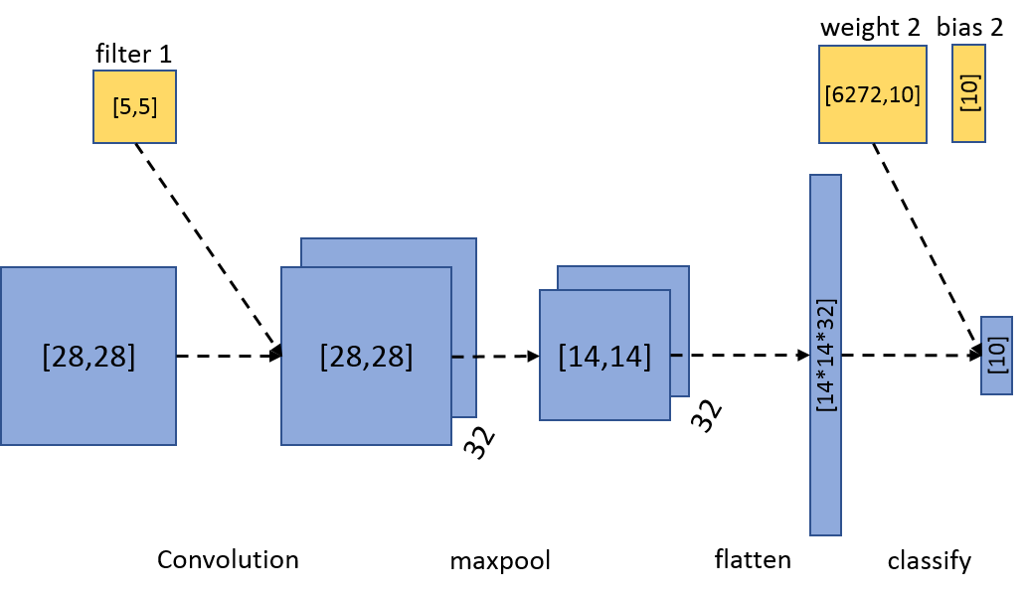
Implement First CNN Layer (3)
Apply weight and bias to map to the 10 digits classification
Apply softmax to normalize
# Map the features to 10 classes, one for each digit
with tf.name_scope('fc-classify'):
W_fc2 = weight_variable([14 * 14 * 32, 10])
b_fc2 = bias_variable([10])
fc = tf.matmul(h_pool_flat, W_fc2) + b_fc2
# Define our loss.
with tf.name_scope('loss'):
# Use more numerically stable cross entropy.
cross_entropy = tf.reduce_mean(
tf.nn.softmax_cross_entropy_with_logits(
labels=y_, logits=y),
name='cross_entropy')
Notes:
This step is similar to the regression-softmax model, only the weight is rewired to fit the tensor shape

Slide 66
Implement Second CNN Layer (1)
See #13 in hand-out
Similarly, generate 64 images from the 32 images using different filters (can choose a different number)
These represents 64 features at a more abstract level
# Second convolutional layer -- maps 32 feature maps to 64.
with tf.name_scope('conv2'):
W_conv2 = weight_variable([5, 5, 32, 64])
b_conv2 = bias_variable([64])
x_conv2 = tf.nn.conv2d(h_pool1, W_conv2, strides=[1, 1, 1, 1], padding='SAME')
h_conv2 = tf.nn.relu(x_conv2 + b_conv2)
# Second pooling layer.
with tf.name_scope('pool2'):
h_pool2 = tf.nn.max_pool(h_conv2, ksize=[1, 2, 2, 1],
strides=[1, 2, 2, 1], padding='SAME')

Slide 67
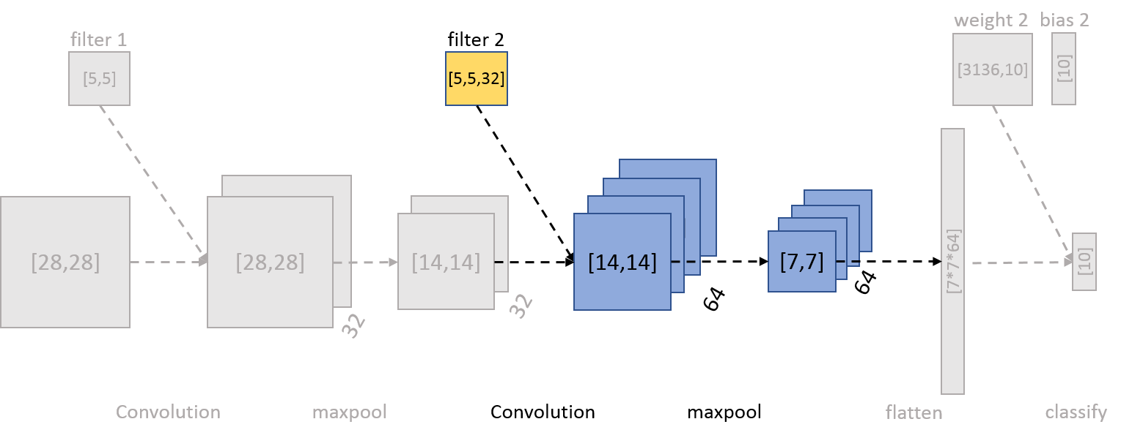
Implement Second CNN Layer (3)
with tf.name_scope('flatten'):
h_pool_flat = tf.reshape(h_pool2, [-1, 7 * 7 * 64])
# Map the features to 10 classes, one for each digit
with tf.name_scope('fc-classify'):
W_fc2 = weight_variable([7 * 7 * 64, 10])
b_fc2 = bias_variable([10])
fc = tf.matmul(h_pool_flat, W_fc2) + b_fc2
Notes:
After 2 rounds of downsampling, our 28x28 image is down to 7x7 with 64 feature maps.

Slide 68
Implement Fully Connected Layer
See #14 in hand-out
with tf.name_scope('fc1'):
h_pool_flat = tf.reshape(h_pool2, [-1, 7 * 7 * 64])
W_fc1 = weight_variable([7 * 7 * 64, 1024])
b_fc1 = bias_variable([1024])
h_fc1 = tf.nn.relu(tf.matmul(h_pool_flat, W_fc1) + b_fc1)
with tf.name_scope('fc-classify'):
W_fc2 = weight_variable([1024, 10])
b_fc2 = bias_variable([10])
fc = tf.matmul(h_fc1, W_fc2) + b_fc2

Slide 69
Implement Dropout Layer
# Dropout - controls the complexity of the model, prevents co-adaptation of features.
with tf.name_scope('dropout'):
keep_prob = tf.placeholder(tf.float32)
h_fc1_drop = tf.nn.dropout(h_fc1, keep_prob)
with tf.name_scope('fc-classify'):
W_fc2 = weight_variable([1024, 10])
b_fc2 = bias_variable([10])
fc = tf.matmul(h_fc1_drop, W_fc2) + b_fc2
….
for i in range(1100):
if i % 5 == 0:
summary, _ = sess.run([merged, accuracy], feed_dict={x: batch[0], y_: batch[1], keep_prob: 1.0})
if i % 100 == 0:
train_accuracy = accuracy.eval(feed_dict={x:batch[0], y_: batch[1], keep_prob: 1.0})
sess.run(train_step, feed_dict={x: batch[0], y_: batch[1], keep_prob: 0.5})
print("Test Accuracy %g" % sess.run(accuracy, feed_dict={x: mnist.test.images, y_: mnist.test.labels,
keep_prob: 1.0}))
Notes:
Add a new placeholder for the dropout probability: set this dropout to .5 for training, and to 1 for any other run

Slide 70
10. Embedded Visualizer

Slide 71
Embedded Visualizer (1)
See #16 in hand-out
Setup a 2D tensor to holds your embeddings
Save your model variables in a checkpoint periodically
Associate metadata with your embedding (optional)
import os
import sys
import urllib
if sys.version_info[0] >= 3:
from urllib.request import urlretrieve
else:
from urllib import urlretrieve

Slide 72
Implement visualizer (2)
Add histograms
tf.summary.histogram("weights", W_conv1)
tf.summary.histogram("biases", b_conv1)
tf.summary.histogram("activations", h_conv1)
# Display the image after max pooling on tensorboard
h_pool1_image = tf.reshape(h_pool1, [-1, 14, 14, 1])
tf.summary.image('conv1', h_pool1_image, 4)
tf.summary.histogram("weights", W_conv2)
tf.summary.histogram("biases", b_conv2)
tf.summary.histogram("activations", h_conv2)
# Display the image after max pooling on tensorboard
h_pool2_image = tf.reshape(h_pool2, [-1, 7, 7, 1])
tf.summary.image('conv2', h_pool2_image, 4)
tf.summary.histogram("weights", W_fc1)
tf.summary.histogram("biases", b_fc1)
tf.summary.histogram("activations", h_fc1)

Slide 73
Implement visualizer (3)
# Get sprite and labels file for the embedding projector
GITHUB_URL =
'https://raw.githubusercontent.com/mamcgrath/TensorBoard-TF-Dev-Summit-Tutorial/master/'
urlretrieve(GITHUB_URL + 'labels_1024.tsv', LOGDIR + 'labels_1024.tsv')
urlretrieve(GITHUB_URL + 'sprite_1024.png', LOGDIR + 'sprite_1024.png')
# Setup embedding visualization
embedding = tf.Variable(tf.zeros([1024, 1024]), name="test_embedding")
assignment = embedding.assign(h_fc1_drop)
saver = tf.train.Saver()
config = tf.contrib.tensorboard.plugins.projector.ProjectorConfig()
embedding_config = config.embeddings.add()
embedding_config.tensor_name = embedding.name
embedding_config.sprite.image_path = LOGDIR + 'sprite_1024.png'
embedding_config.metadata_path = LOGDIR + 'labels_1024.tsv'
# Specify the width and height of a single thumbnail.
embedding_config.sprite.single_image_dim.extend([28, 28])
tf.contrib.tensorboard.plugins.projector.visualize_embeddings(writer, config)

Slide 74
Implement visualizer (4)
See #16 in hand-out
# Do the training.
for i in range(1100):
...
if i % 500 == 0:
sess.run(assignment, feed_dict={x: mnist.test.images[:1024], y_: mnist.test.labels[:1024], keep_prob: 1.0})
saver.save(sess, os.path.join(LOGDIR, "model.ckpt"), i)

Slide 75
11. Summary

Slide 76
Recap
TensorFlow community
Programming concepts:
graph, tensor, node, operation
MNIST:
Simple model: regression
Complex model: convolution
Tools:
Debugger
Tensorboard

Slide 77
Further study
Cognitive AI classes: https://cognitiveclass.ai/
Deep Learning 101
Deep Learning with TensorFlow
Other problem domains:
Speech to Text (https://voice.mozilla.org/)
Reading comprehension (https://github.com/allenai/deep_qa)
Language Translation
Self-driving car
...
Notes:
In the Deep Learning with TensorFlow class, the same 2 models are used. Presented from a different perspective
Also cover RNN, Unsupervised Learning, Autoencoder
Generally very active development in many areas

Slide 78
Thank You
Ton Ngo Paul Van Eck Winnie Tsang
ton@us.ibm.com pvaneck@us.ibm.com wtsang@us.ibm.com
IBM Cognitive OpenTech Group

